Slide 1



ecx.io Frontend Bootcamp — Interactivity and HTML forms 12.07.2021.

Slide 2

Agenda
Anchor vs. Button
Intro to forms
[lunch break]
Form controls
Form validation

Slide 3


Recap of Friday Exercise

Slide 4
HTML day 04 - Friday exercise
Pull the latest changes on „html-day-04” branch in the bootcamp workshop repository. There is an html file and assets. Do the following tasks:
Add the logo to the header of the page.
Embed the youtube video to the main article content: https://www.youtube.com/watch?v=kR8dPbrDeV4.
Add the responsive images to the further info section, where we want to show different images in different viewports.
Target mobile, tablet and desktop screens (choose the viewport definition on your own)

Slide 5
Anchor vs. Button

Slide 6
Anchor vs. Button
When we talk about interactivity on the web, it all goes down to two elements.
<a> anchor
<button> button
Source: http://www.agocg.ac.uk/reports/mmedia/handbook/hndbk3.htm

Slide 7
Anchor
<a> creates a hyperlink to web pages, files, email addresses, or anything reachable via URL.
While focused (and ”href” attr present), Enter key will activate it.
For screen readers, when anchor is clicked, navigation to another page (or section) is expected.

Slide 8
Button
<button> represents a clickable button, used to submit forms, or for any other dynamic behavior.
While focused, Enter or Space keys will activate it.
For screen readers, they will announce that element is a button and therefore clickable.
3 types of button
submit (default) – submits the form data
reset – resets the form controls to their initial value
button – does nothing when activated (JS handler has to be developed)

Slide 9
So, what’s the problem?

Slide 10
So, what’s the problem?
The actual problem and confusion lies in hands of developers ☺
In significant amount of cases, wrong element is used for wrong purpose, and their behavior is modified via JavaScript.

Slide 11
So, what’s the problem?
This code works ☺.
In most cases, for most of the users ☹.
Issues:
”href” attribute should be meaningful.
Although ”role” was set to button, some things are missing in order for it to work like a button.
Most important: Space key should activate it too.
For more details, see reference.

Slide 12
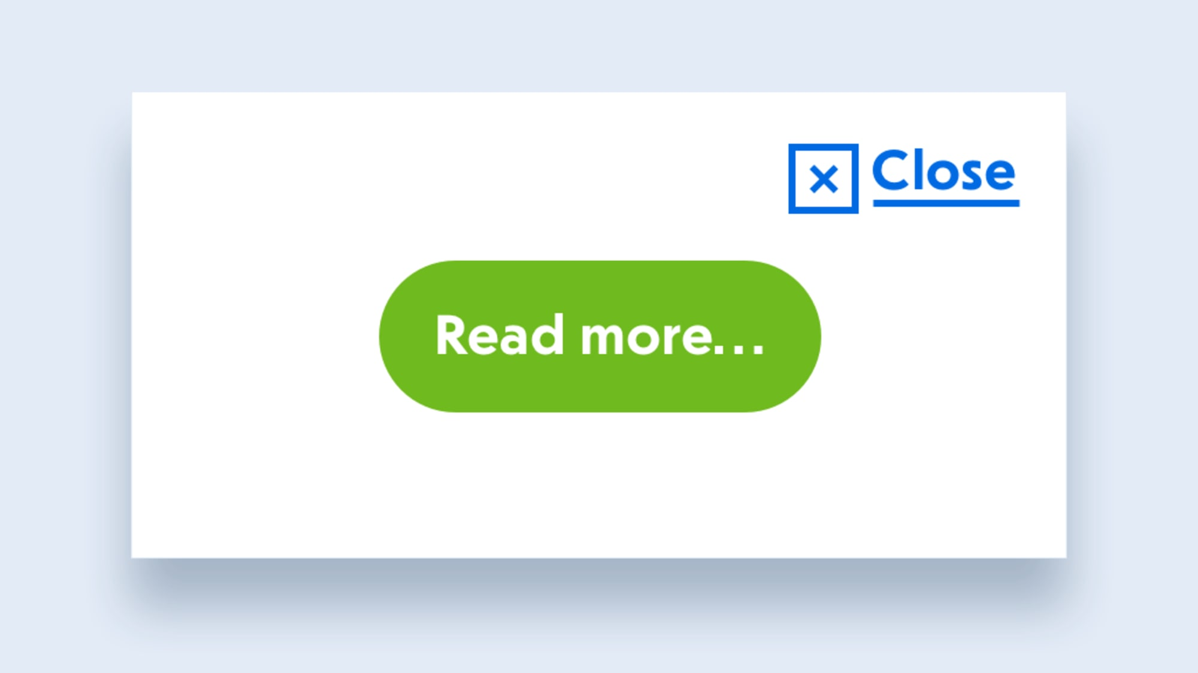
The link or button dilemma
Which element should we use?
“Read more…” will most probably lead the user to a different page
(but it looks completely like a button!)
“X Close” will most probably close the popup dialog
(but it looks completely like a link!)
Source: https://www.smashingmagazine.com/2019/02/buttons-interfaces

Slide 13
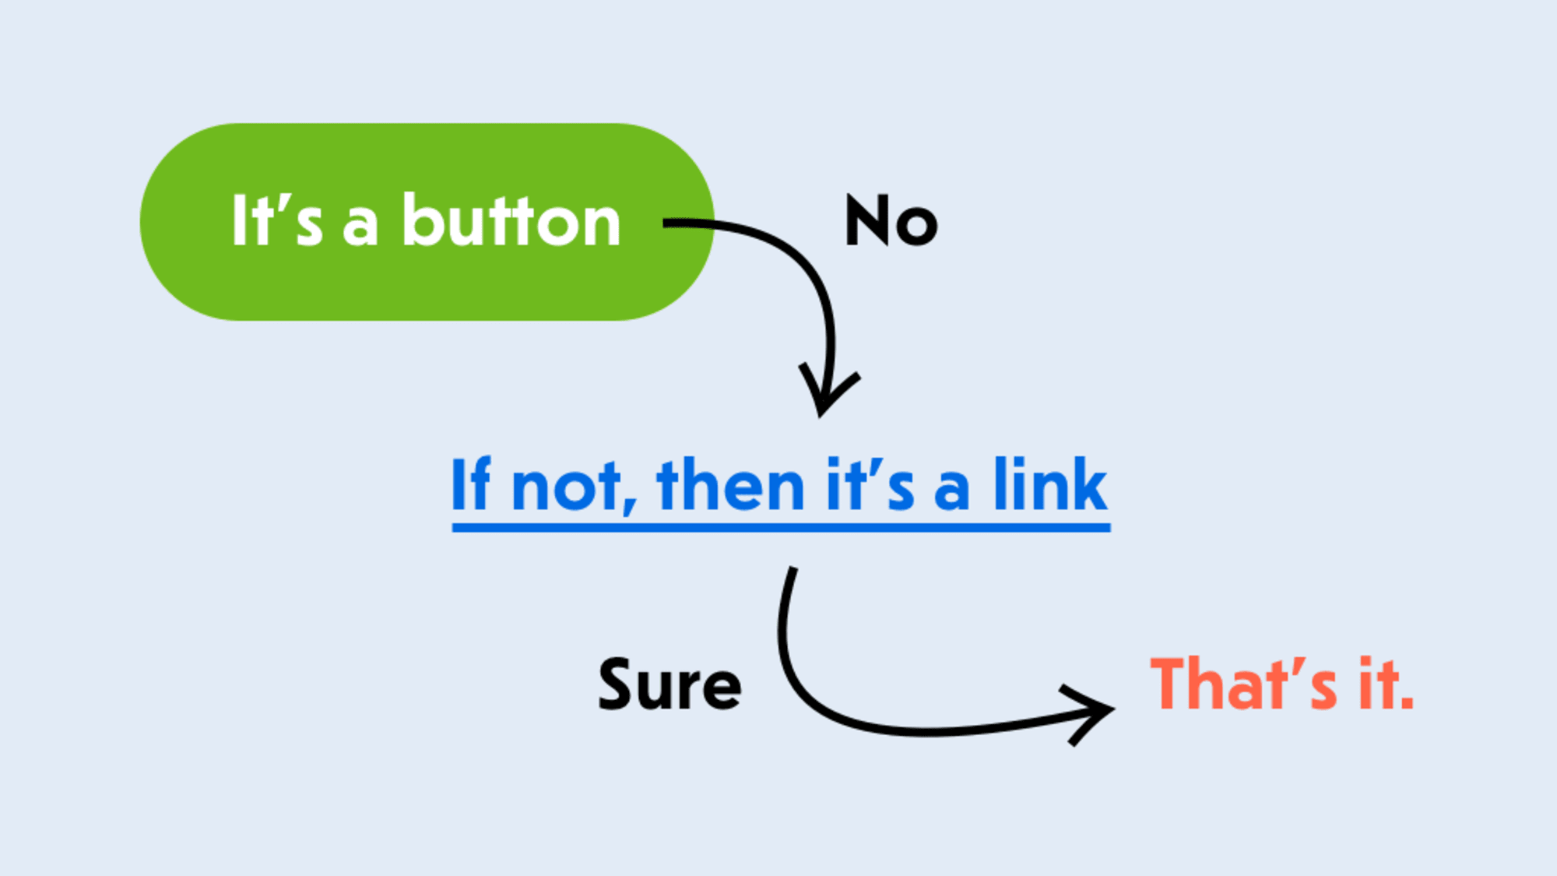
The link or button dilemma
In the end, it’s very simple… ☺
Source: https://www.smashingmagazine.com/2019/02/buttons-interfaces

Slide 14
Intro to forms

Slide 15
Intro to forms
Forms are main point of interaction between the user and website.
Users can enter data, which is submitted for processing and storage, or used on client-side to update the UI.
Forms consist of one or more form controls.
Form controls can be text fields, dropdowns, etc. They can also enforce specific value formats or ranges.

Slide 16

Keep the forms as short as possible. Ask only for the data that is absolutely needed.

Slide 17
The <form> element
Wrapper for the form.
Has specific attributes for form-handling purposes, all of them are optional.
Standard practice is to always set at least two:
action – location where the form should be submitted
method – defines the HTTP method to send the data

Slide 18
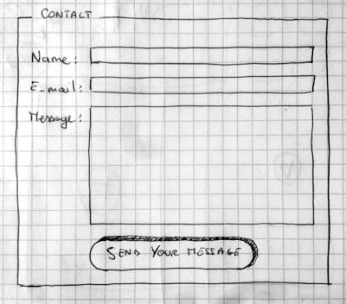
The <form> element
Let’s try to create our simple form!
It should consist of 3 text fields, each with a label
- name, a single-line text field
- email, an email field
- message, a multi-line text field

Slide 19
The <form> element
We’ve used <label> for every field, to set an explicit label for each form control.
We’ve used different types of <input>:
- text – a default type and represents a basic single-line text field
- email – defines a single-line field which only accepts email addresses
We’ve used the <textarea> which requires a closing tag.

Slide 20
The <form> element
Difference in setting the default value.
Empty element uses ”value” attribute.
Non-empty element has the value between opening and closing tags.

Slide 21
Submit button
We’re missing a button to submit the form.
Let’s add a <button> element.

Slide 22
Submit button
Button has 3 types:
submit (default) – submits the form data to the location defined by “action” attribute
reset – resets the form controls to their initial value. From UX perspective, this is considered as bad practice, so it’s not used that often
button – does nothing when activated (JS handler has to be developed)

Slide 23
Sending the data
Data is submitted to the location defined in “action” attribute, with a HTTP method defined in “method” attribute.
Data has a key/value form, where key is the form control’s “name” attribute, and value it’s value.
Let’s see how that works.

Slide 24
Sending the data
GET method
Data is appended to the URL.
POST method
Data is added to the request body.

Slide 25
Form structure
Flexibility of forms is making them one of the most complex structures in HTML.
Using the correct structure will help ensure that the form is both usable and accessible.
Important: it is forbidden to nest a form inside another form.

Slide 26
Fieldset and legend
<fieldset> is a convenient way to create groups of widgets that share the same purpose.
<legend> labels the <fieldset> group.
Some screen readers will read the legend before the label of each form control.

Slide 27
Labels
With <label>, we’re defining a label for the form control.
Explicit association with “for” attribute.
Implicit association with nesting the form control inside <label>.
- it is a good practice to keep the “for” attr
Labels are clickable! They either focus the control, or select them (e.g. checkbox).

Slide 28
General structure
Besides form specific HTML elements, form markup is “just HTML” and all the HTML power can be used to structure a form.
In most cases, following elements are used:
<div>
<ul> with <li>s
Common practice is to use HTML headings and/or <section> to separate sections of complex forms.

Slide 29
Form controls

Slide 30
Text input fields

Slide 31
Text input fields
Common behavior:
Can me marked as readonly or disabled
Can have a placeholder
Can be constrained with maxlength
Can benefit from the spell checking with spellcheck attribute

Slide 32
Simple text field
Most basic example.
Allows the user to enter a single-line text content.

Slide 33
Password field
Does not add any special constraint to the field or text.
It only obscures the value, that it cannot be read by others.

Slide 34
Hidden field
Form control which is not actually visible to the user.
It is still submitted to server.
It will never receive focus, and screen reader will not notice it.
Example usage: a timestamp when the order is placed.

Slide 35
Email field
Used to enter valid email addresses.
By providing “multiple” attribute, it can receive multiple addresses, separated with comma.

Slide 36
Search field
Input that has a trigger to clear the value.

Slide 37
Phone field
Similar as for emails, input that receives a telephone value.
While focused on mobile, a keypad keyboard will be displayed.
There is no restriction to enter only numbers, due to different phone number format around the world.

Slide 38
URL field
Special type to enter URLs.
It will include a validation for a valid URL.

Slide 39
Numeric field
Allows only numbers to be entered.
By default, it provides two buttons to increase/decrease the value.
On mobile, it will open a numeric keyboard.
Attributes:
min – the minimum value
max – the maximum value
step – steps that are allowed (default: 1). If float number wanted, use ”any” or specific “0.01”

Slide 40
Range field
Another way to pick a number.
Most common usage in filters for the price range on web shops.
From usage perspective, they are less accurate than numeric inputs => should be used when precise value is not important.
We should always configure “min”, “max” and “step” attributes.

Slide 41
Range field
Issue: we don’t have a visual feedback of the currently selected value.
We can use <output> element next to the slider.

Slide 42
Range field
Issue: we don’t have a visual feedback of the currently selected value.
We can use <output> element next to the slider.
We need to implement the JS behavior in order to get the value.

Slide 43
Checkable items

Slide 44
Checkable items
Their state changes when clicking on them (or their labels).
Different behavior on form submit. Unless checked, “name” won’t be submitted.
Good practice is to include the list of related checkable items to <fieldset> with it’s <legend>.

Slide 45
Checkbox
Used for setting the “true/false” values.
With multiple items (multiselection), all of them should have the same “name” attribute.

Slide 46
Radio button
Used for single selection out of multiple items.
A single radio button does not make much sense.

Slide 47
Exercises
Create a form which will ask for following fields: - username - password - subscription to newsletter

Slide 48
File picker

Slide 49
File picker
Used for sending files to server.
Can send one or more files.
Allows specification for file types.

Slide 50
Date and time pickers

Slide 51
Date and time pickers
Date
The most simple type of date picker.
Note: All date pickers can have “min”, “max” and “step” attributes.

Slide 52
Date and time pickers
Datetime-local
Picking date and time, in user’s local timezone.

Slide 53
Date and time pickers
Month
Picking the month of the year.

Slide 54
Date and time pickers
Time
Picking the time value.
Will always be submitted in 24-hour format, while it might be displayed in 12-hour format, depending on the locale of user.

Slide 55
Date and time pickers
Week
Picking the week of the year.

Slide 56
Color picker

Slide 57
Color picker
Always returns 6-digit hexadecimal color code as value.

Slide 58
Dropdowns

Slide 59
Select
<select> is the most simple dropdown control.
Contains one or more <option> elements
“value” attr is not mandatory. If not present, the inner content is considered as value.

Slide 60
Select
<optgroup> to group options
“multiple” to allow multiple choice with (“Ctrl/Cmd” + click)

Slide 61
Autocomplete
Default suggested, autocomplete list with <datalist>.
Different choices can be added with <option>.
It must have “id” attr, to bind it to the <input> element.

Slide 62
Common attributes

Slide 63
autofocus – the element should have initial focus on page load
disabled – user cannot interact with the element, and the value will not be submitted
form – the identifier of <form>, if the field is used outside of it
name – the name of the element
value – initial value of element

Slide 64
Exercises
Create a form which will ask for following fields: - first name - last name - email - favourite dinosaur (single selection) - image of dinosaur - favourite frontend technologies (multiple selections) - favourite color - slider (range) for years of experience with frontend (min: 0, max: 15, step: 0.5) - month picker for month when user started with frontend - autocomplete with favourite food

Slide 65
References
https://bitsofco.de/anchors-vs-buttons
https://css-tricks.com/use-button-element
https://developer.mozilla.org/en-US/docs/Learn/Forms
https://developer.mozilla.org/en-US/docs/Web/HTML/Element#forms
https://developer.mozilla.org/en-US/docs/Learn/Forms/HTML5_input_types

